Slide 1
CS6451: Advanced Software Design
Lecture K: The Adapter Design Pattern
J.J. Collins
Dept. of CSIS
University of Limerick

Slide 2
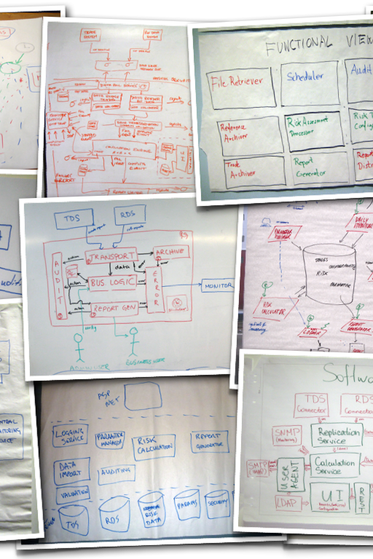
Objectives
Outline class and object adapters.
Pluggable Adapters.
2-Way Adapters
Excerpt from Erich Gamma, Richard Helm, Ralph Johnson, and John Vlissides. Design Patterns. Elements of Reusable Object-Oriented Software. 1995. Addison-Wesley.
Excerpts from Judith Bishop's text C# 3.0 Design Patterns: Use the Power of C# 3.0 to Solve Real-World Problems. SAMS. 2007.
Advanced Software Design
© www.infoq.com

Slide 3

Part 1
Adapter 101
Software Design

Slide 4
What if…
  A class has the functionality required but not the interface expected?
  Edit the class code?
  What if the source code is not available?

Slide 5
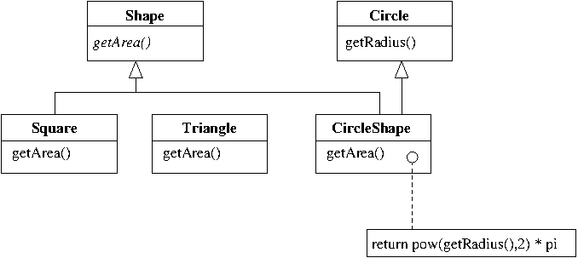
The Class Adapter: using inheritance

Slide 6
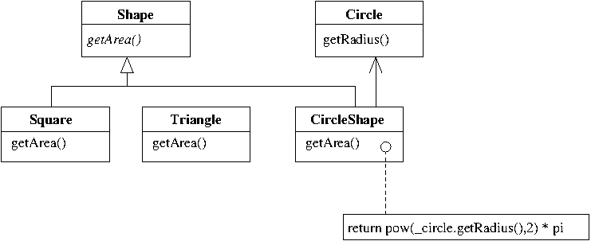
The Object Adapter: using delegation

Slide 7

The Adapter: Wrapping Invocations
Inheritance
  ‘extend’ the class with the functionality
  ‘implement’ the desired interface
  → Class Adapter
Delegation
  Instantiate the class with the functionality
  ‘implement’ the desired interface
  → Object Adapter

Slide 8
The Adapter: Roles
ITarget
  the interface that the client wants to use → Shape
Adaptee
  An implementation that must be adapted to the interface ITarget i.e. one that the client wants to use → Circle
Adapter
  Implements ITarget in terms of Adaptee → CircleShape
Request
  Domain specific signature that the clients uses → getArea()
SpecificRequest
  The implementation that must be invoked → getRadius()
The Adapter adapts Adaptee to match the expected interface ITarget

Slide 9
public interface Shape {
public float getArea();
}
public class Square implements Shape{
private float sideLength;
public Square(float sLength) {
this.sideLength = sLength;
}
public float getArea(){
return sideLength * sideLength;
}
}

Slide 10
public class Circle {
private float radius;
public Circle(float r){
this.radius = r;
}
public float getRadius() {
return radius;
}
}
public class CircleShape extends Circle implements Shape {
public CircleShape(float radius) {
super(radius);
}
public float getArea() {
return getRadius()*getRadius()*3.14f;
}
}

Slide 11
public class Driver {
public static void main(String args[]) {
Shape s = new CircleShape(10);
System.out.println(s.getArea());
}
}

Slide 12
public class CircleShape2 implements Shape {
Circle _circle = null;
float radius;
float pi = 3.14f;
public CircleShape2(float radius) {
this.radius = radius;
_circle = new Circle(radius);
}
public float getArea() {
// return _circle.getRadius()*_circle_getRadius()*pi;
return radius * radius * pi;
}
}

Slide 13

The Adapter: Consequences
The Class Adapter
Commits to a class
  Will not work with its subclasses.
  Adapter can override an Adaptee’s behaviour.
  Only one object is introduced.
The Object Adapter
An Adapter can work with many Adaptees:
  Any subclass of the Adaptee can be an adaptee
  Functionality is added to all adaptees at once
More difficult to override Adaptee behaviour
  Adaptee must be subclassed
Advanced Software Design
© www.infoq.com

Slide 14
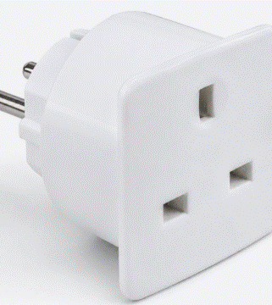
The Adapter: Issues
How much adaptation?
  Change behaviour completely?
  Add a getPerimeter() method.
    Where does it go?
Pluggable adapters
  Built-in interface adaptation
Two-way adapters
  To allow a CircleShape be used as a circle?
CS6451

Slide 15

Classic Adapter Example
Old Macs shipped with PowerPC chip
Mac OS X called the AltiVec floating point and integer SIMD instruction set
In 2006, Apple switched to Intel
Mac OS X calls to AltiVec had to be retargeted to Intel x86 SSE instructions
Accelerate framework: a set of high performance vector accelerated libraries
Adapts x86 SSE instruction set to AltiVec
( CS6451 )
© www.infoq.com

Slide 16
Part 2
Pluggable Adapter
Software Design

Slide 17

Pluggable Adapter
Recognising that your system will need to work with other systems increases the chance of a successful adaptation.
A class is more reusable when you minimise the assumptions that other classes make about it.
The pluggable adapter achieves both of these aims.
It lets us incorporate a class into existing systems that expected different interfaces.
Software Design
© www.infoq.com

Slide 18
Pluggable Adapter:
Example:
You develop a TreeDisplay widget to display trees graphically.
To be used in one application only.
Objects that it displays are derived from Tree abstract class.
Other applications should be able to use this display widget
  i.e. a directory browser using getSubdirectory()
  i.e. an app that displays inheritance structures in a code base using getSubclass()
  i.e. An implementation of the Composite based on getComponent()
  Using their own classes for tree structures

Slide 19

Pluggable Adapter: GoF Approach
Define narrow interface for adaptee
Then, three options:
Using abstract operations in Target
Using delegate objects
Parameterised adapters
  Not covered in CS4227
CS5721

Slide 20
Pluggable Adapter: The Narrow Interface
Identify the parts of the system that may change
Define NARROW interfaces
The smallest subset of operations that lets us do the adaptation
A narrow interface consisting of a ‘few’ signatures is easier to adapt than a wide interface
Makes it easier to plug in new adapters
For TreeDisplay, the adaptee is any hierarchical structure.
2 operations
GetChildren(Node): retrieves a node’s children
CreateGraphicNode(): how to graphically present a node

Slide 21
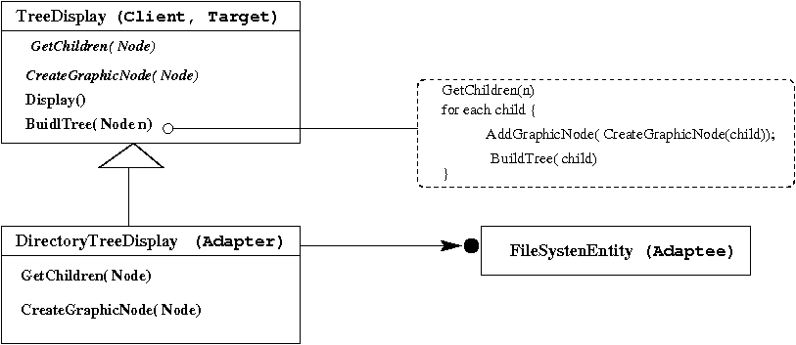
Pluggable Adapter: Using Abstract Operations

Slide 22
Pluggable Adapter: using delegate objects
TreeDisplay forwards requests to a delegate object when accessing the hierarchical structure.
TreeDisplay can use a different adaptation strategy by substituting a different delegate.
For example, suppose there exists a DirectoryBrowser that uses TreeDisplay
Mixin the narrow interface into the delegate – DirectoryBrowser, using inheritance.

Slide 23
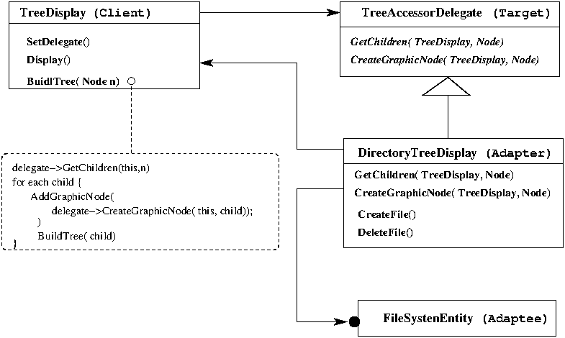
Pluggable Adapter: Using Delegate Objects

Slide 24
Pluggable Adapter
The pluggable adapter allows a system (an adaptee) to be plugged in.
The adaptee’s methods are assigned to delegate objects, and the association lasts until a different system is plugged in.
A pluggable adapter has a parameterised constructor for each of the types that it adapts.

Slide 25
Part 2
Delegates
Used in
Pluggable Adapter
Software Design

Slide 26
1. Introducing Delegates
A delegate is a reference type that defines the signature/interface for a method call.
The delegate can then accept and execute any method that has the same signature.
Delegates sometimes compared (contrasted) with interfaces
  An interface is a reference type that defines the layout of a class, but has no implementation defined
  A delegate defines the layout for a method.

Slide 27
1. Introducing Delegates
Implement a library for sorting numbers.
Many different sorts, not sure which ones to support
  Lets be minimalistic.
The library should be easily extensible in that client developers can implement their own sort but have it called through the library interface.

Slide 28
1. Introducing delegates in C#
public class MySort
{
public delegate void Sort(ref int a, ref int b);
public static void DoSort(Sort ar, ref int val1, ref int val2)
{
ar(ref val1, ref val2);
}
public static void Ascending(ref int x, ref int y)
{
if (x > y)
{
int tmp = x;
x = y;
y = tmp;
}
}
}

Slide 29
1. Introducing delegates in C#
public class Program
{
public static void Descending(ref int x, ref int y)
{
if (x < y)
{
int tmp = x;
x = y;
y = tmp;
}
}

Slide 30
1. Introducing delegates in C#
public static void Main(string[] args)
{
MySort.Sort up = new MySort.Sort(MySort.Ascending);
MySort.Sort down = new MySort.Sort(Descending);
int val1 = 99;
int val2 = 100;
MySort.DoSort(up, ref val1, ref val2);
Console.WriteLine(" after asscending Sort: val1 ={0}, val2 = {1}",
val1, val2);
MySort.DoSort(down, ref val1, ref val2);
Console.WriteLine(" after descending Sort: val1 ={0}, val2 = {1}",
val1, val2);
……………………………………..
}
}
}

Slide 31
1. Introducing delegates in C#
Declare the delegate
  public delegate returnType DelegateName(parameters);
  public delegate void Sort(ref int a, ref int b);
Define implementations
  For sorting algorithms i.e. Ascending
Instantiate delegate objects and associate them with implementation
  Sort up = new Sort(Ascending)
  This creates a delegate object named up is associated with the implementation defined for the method Ascending
Execute the implementation associated with the delegate
  Invoke a generic method that takes a delegate object as a parameter and executes it
      MySort.DoSort(up, val1, val2);

Slide 32
1. Introducing delegates in C#
public static void Main(string[] args)
{
MySort.Sort up = new MySort.Sort(MySort.Ascending);
MySort.Sort down = new MySort.Sort(Descending);
MySort.Sort test = new MySort.Sort(delegate(ref int x, ref int y) {
if (x < y) { int tmp = x; x = y; y = tmp; }
});
int val1 = 99;
int val2 = 100;
up(ref val1, ref val2);
Console.WriteLine(" after asscending Sort: val1 ={0}, val2 = {1}",
val1, val2);
down(ref val1, ref val2);
Console.WriteLine(" after descending Sort: val1 ={0}, val2 = {1}",
val1, val2);
test(ref val1, ref val2);
Console.WriteLine(" after descending Sort: val1 ={0}, val2 = {1}",
val1, val2);
……………………………………..
}
}
}

Slide 33
Part 2
Back to
Pluggable Adapter
Software Design

Slide 34
Pluggable Adapter
// Plugable Adapters
// Based on Judith Bishop's text C# 3.0 Design Patterns: Use the Power of C# 3.0 to Solve Real-World Problems. SAMS. 2007.
// We provide Estimate()
// May want to use Precision(), a third party API
namespace PlugabbleAdapter
{
// T A R G E T
public interface ITarget {
string Estimate(int i);
}
class Target : ITarget {
public string Estimate(int i){
return "TARGET: Estimate is " +
(int)(Math.Round((double)i / 3.0));
}
}

Slide 35
Pluggable Adapter
// A D A P T E E
public interface IAdaptee
{
double Precision(double a, double b);
}
class Adaptee: IAdaptee
{
public double Precision(double a, double b)
{
return a / b;
}
}

Slide 36
Pluggable Adapter
// A D A P T E R
class Adapter : Adaptee {
// declare a delegate that specifies the target --> string name(int)
public Func<int, string> RequestDelegate;
// Option 1: Set the delegate to the new standard i.e. Precision()
// Adapter-Adaptee
public Adapter(IAdaptee adaptee) { // why parameterise ????
RequestDelegate = delegate(int i) {
return "ADAPTEE: Estimate based on precision is “
+(int)Math.Round(Precision(i, 3));
};
}

Slide 37
Pluggable Adapter
// ADAPTER Class continued
// Option 2: set the delegate to the existing standard - Estimate()
//Adapter-Target
public Adapter(ITarget target) {
RequestDelegate = target.Estimate;
}
// Option 3: set the delegate to any standard
// Adapter Target/Any_Adaptee
public Adapter(Func<int, string> r) {
RequestDelegate = r;
}
}

Slide 38
Pluggable Adapter
class Program {
static void Main(string[] args) {
IAdaptee adaptee = new Adaptee();
ITarget target = new Target();
Console.WriteLine(adaptee.Precision(2,3));
Console.WriteLine(target.Estimate(2));
// use the new standard, messy (Option 1)
Adapter adapter1 = new Adapter(new Adaptee());
Console.WriteLine("adapter1: " +
adapter1.RequestDelegate(2));

Slide 39
Pluggable Adapter
// Main continued
// use the existing standard (Option 2)
Adapter adapter2 = new Adapter(target);
Console.WriteLine("adapter 2: " +
adapter2.RequestDelegate(2))
// use the new standard, messy (Option 3)
Adapter adapter3 = new Adapter(delegate(int i) { return
"Estimate based on precision is " +
Math.Round(adaptee.Precision(i, 3.0));});
Console.WriteLine("adapter 3: " +
adapter3.RequestDelegate(2));
}
}

Slide 40

Pluggable Adapter
The feature of small interfaces gives rise to the term pluggable adapters.
The name of a method called by the client and the signatures in the ITarget interface can be different
Standard adapters: clients uses ITarget
Intro to ANNs and MLPs
© www.infoq.com

Slide 41
Part 3
Two-Way Adapters
Software Design

Slide 42
Two-Way Adapters: Graphics Example
An adapter may not be transparent to all clients.
An adapter nolonger conforms to the Adaptee interface.
  Solution: two-way adapters
Example:
  Graphical Editor Unidraw
  QOCA a constraint solving toolkit
  Both have classes to represent variables
  Unidraw has StateVAriable
  QOCA has ConstraintVVariable

Slide 43
Two Way Adapters: : Graphics Example
To make Unidraw work with QOCA, ConstraintVariable must be adapted to StateVAriable
To make QOCA work with Unidraw, StateVAriable must be adapted to ConstraintVariable
QOCA Class Hierarchy
Unidraw Class Hierarchy
ConstraintVariable
StateVariable
ConstraintStateVariable

Slide 44
Two-Way Adapters
Macs: OS X and Windows
Accelerate automatically invokes the appropriate instruction set be it AltiVec or x86 SSE
Mac OS X
  ExecuteAltiVec(instruction)
Windows
  ExecuteSSE(instruction)
Adapter
  ExecuteAltiVec(instruction) {
    ExecuteSSE(ConverttoSSE(instruction));
  }
  ExecuteSSE(instruction){
    Intel.ExecuteSSE(instruction)
  }

Slide 45
Two Way Adapter
public interface ITarget
{
string Estimate(int i);
}
// Target
class Target : ITarget
{
public string Estimate(int i)
{
return "TARGET: Estimate is " +
(int)(Math.Round((double)i / 3.0));
}
}

Slide 46
Two Way Adapter
public interface IAdaptee
{
double Precsion(double a, double b);
}
// Adaptee
class Adaptee: IAdaptee
{
public double Precision(double a, double b)
{
return a / b;
}
}

Slide 47
Two Way Adapter
class TwoWayAdapter: ITarget, IAdaptee
{
private ITarget target;
private IAdaptee adaptee;
public TwoWayAdapter(ITarget target, IAdaptee adaptee) {
this.target = target;
this.adaptee = adaptee;
}
public double Precision(double a, double b) {
return adaptee.Precision(a,b);
}
public string Estimate(int i) {
return target.Estimate(i);
}
}

Slide 48
Two Way Adapter
class Program {
static void Main(string[] args) {
IAdaptee adaptee = new Adaptee();
ITarget target = new Target();
Console.WriteLine(adaptee.Precision(2,3));
Console.WriteLine(target.Estimate(2));
TwoWayAdapter two = new TwoWayAdapter(target,adaptee);
Console.WriteLine(“ .…. " + two.Precision(2,3));
Console.WriteLine(“ …… " + two.Estimate(2));
ITarget target2 = two;
IAdaptee adaptee2 = two;
Console.WriteLine(“ ….. " + adaptee2.Precision(2, 3));
Console.WriteLine(“ ….." + target2.Estimate(2));
}
}

Slide 49
Exercise
Create a data set consisting of 2 linearly separable classes.
Train a single perceptron to classify samples
Graph performance
Keep the implementation as simple as possible – KISS principles.
Intro to ANNs and MLPs
© www.infoq.com

Slide 50

Reading for Week 8
Any text on the Adapter Design Pattern.

Slide 51
Thank you

